Slide 1
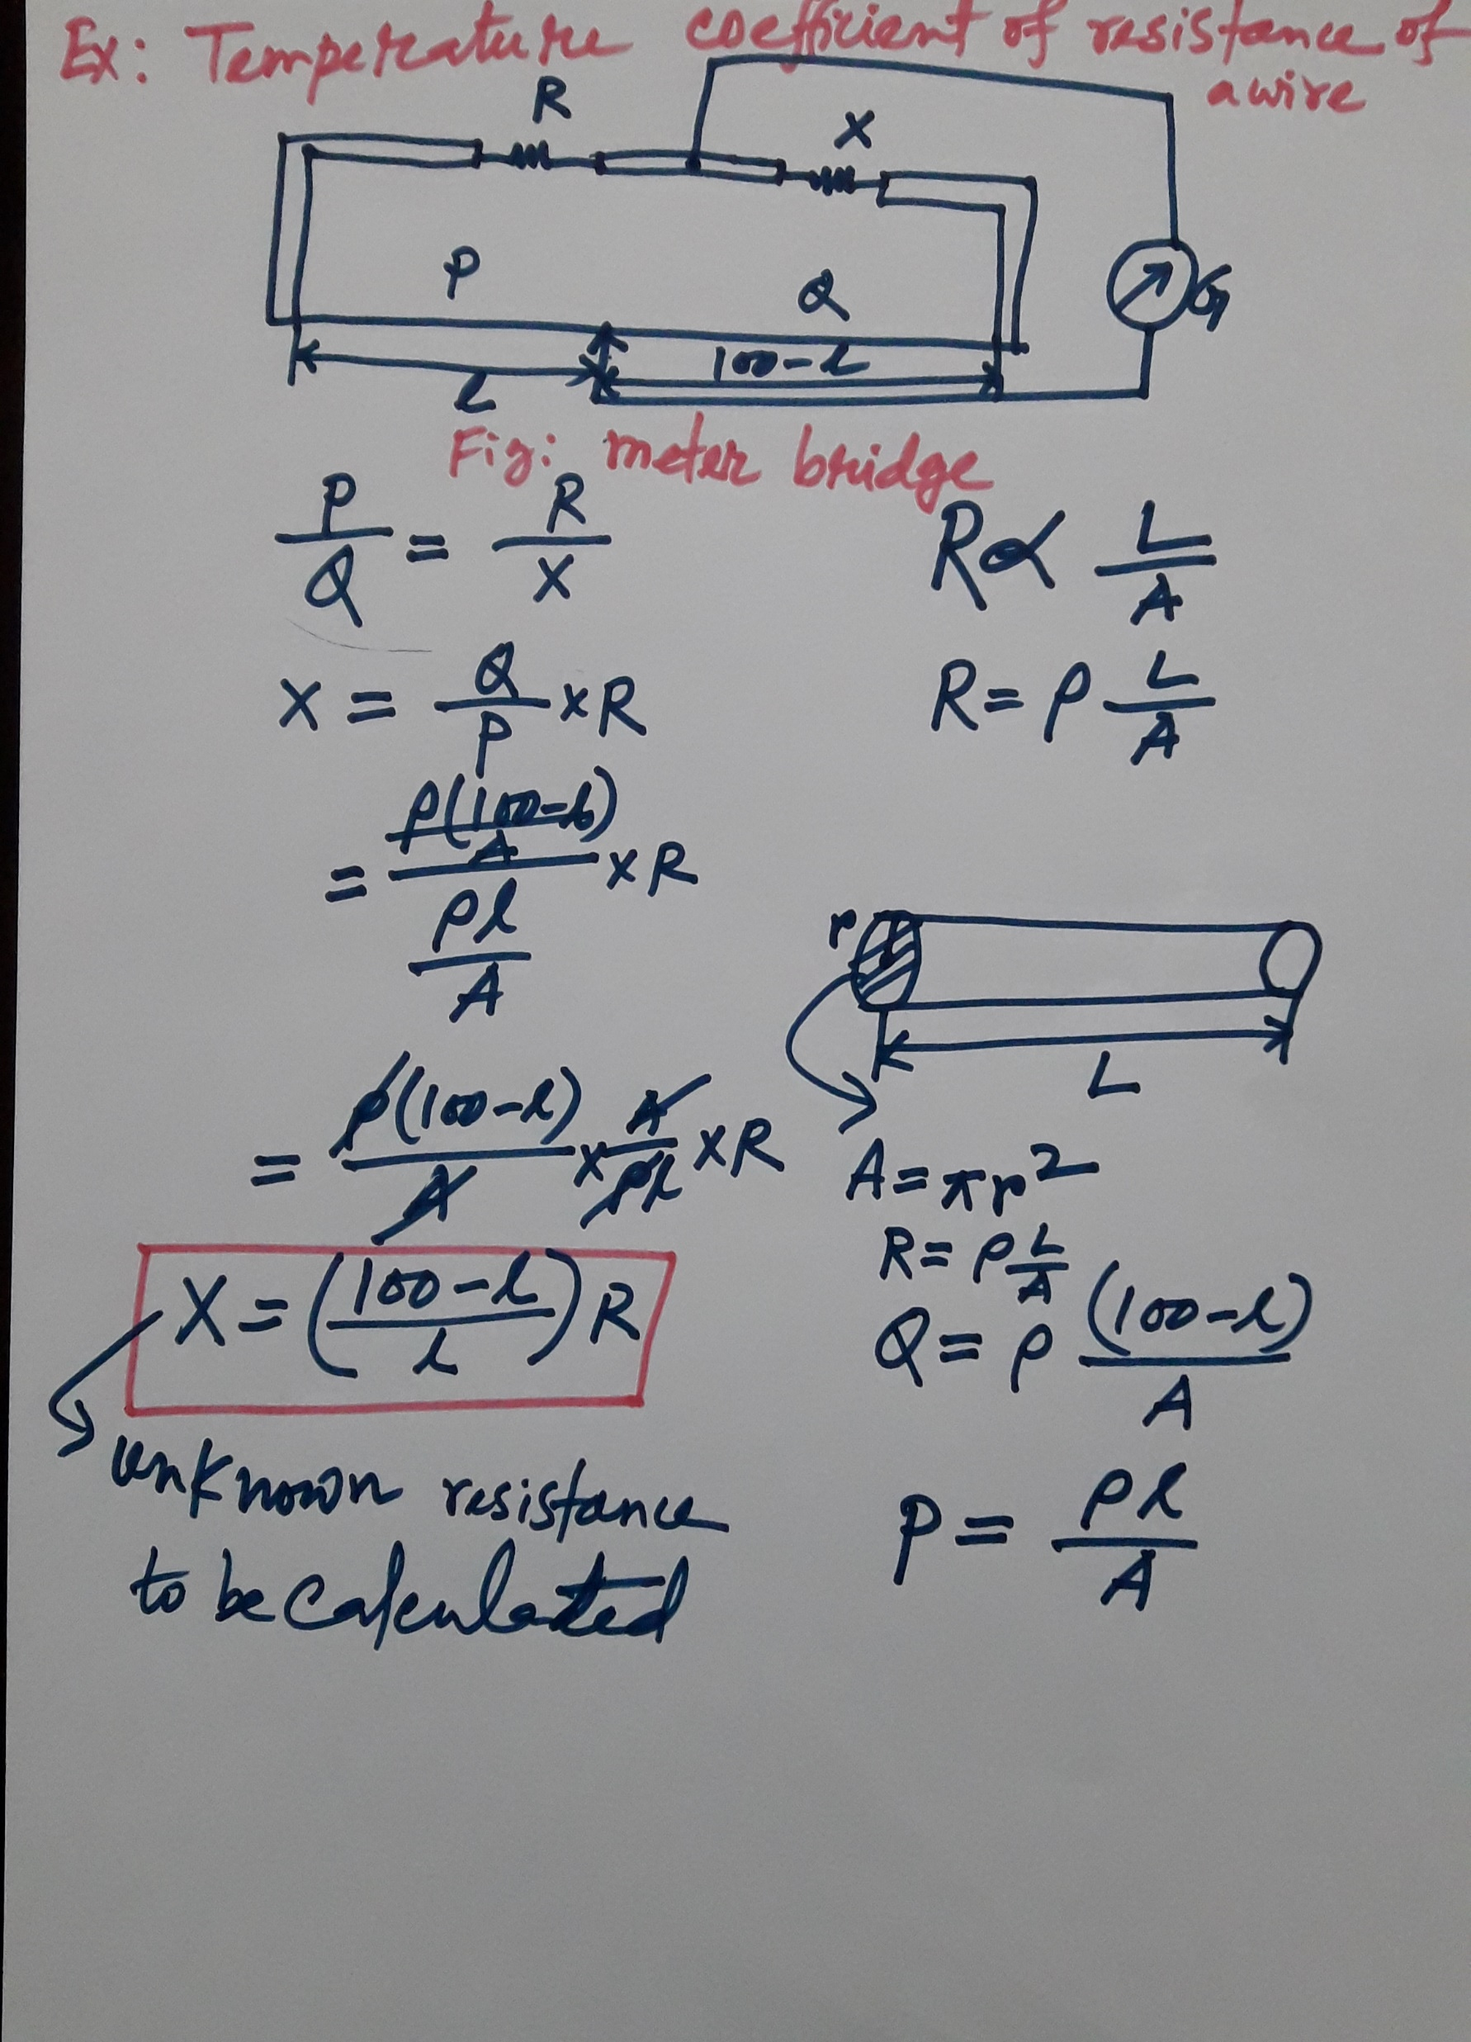
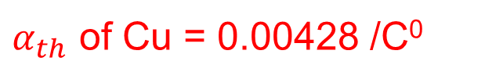
$α_{th}$ of Cu = 0.00428 /C⁰

